Slide 1

HCI Semestral Project
Created by Mykola Bas

Slide 2
Product statement and motivation
Product statement: The “MillionDollarLook” luxury clothes shop allows people to comfortably and merely effortless purchase process of shoes and clothes of the worlds’ fashion brands.
Motivation: The goal of this UI specification is to design of an Internet-shop, for selling luxury clothes and shoes.

Slide 3
Business requirements
Easy-to-use Internet-shop
The items of the shop are sent on delivery
Items in the shop are paid by card only
The shop is oriented on local market (Czech Republic)

Slide 4
Limitations
We are dealing only with the front-end part of the shop
We are ignoring purchasing mechanism
We are ignoring logging in mechanism

Slide 5
Personas
There are three types of personas are defined in order to model end (final) users.
1. Zuzanna Novotná
2. Karel Pokorný
3. Tomáš Krejčí

Slide 6

Persona A (Zuzanna Novotná)
Name - Zuzanna Novotná (40)
Gender - Female
Hobbies: Hiking, yoga, and shopping
Typical day: Zuzanna works as a UX designer at an e-commerce company. She starts her day by checking her emails and going through her to-do list for the day. After that, she usually has a few meetings with her team to discuss ongoing projects and any updates. In the afternoon, she takes a break to go on a short hike to clear her mind and get some exercise. In the evening, she relaxes by doing yoga or shopping some new brand clothes for herself or family members.
Short history: Mrs. Novotná has always been interested in design and technology and has a degree in UX design after her high school graduation. She interned at a few companies before landing a full-time job at a luxury e-commerce company, where she has been working for the past two years.

Slide 7
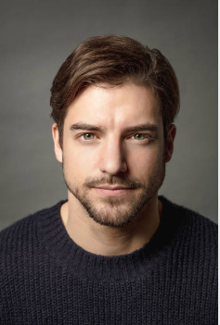
Persona B (Karel Pokorný)
Name - Karel Pokorný (35)
Gender - Male
Hobbies – Tennis, golf, and cooking
Typical day: Karel is a senior product manager at a luxury e-commerce company. He starts his day by checking in with his team to see if there are any urgent tasks that need to be addressed. After that, he usually has a few meetings with various stakeholders to discuss product strategy and gather feedback. In the afternoon, Karel takes a break to play a game of tennis or golf with some friends. In the evening, he enjoys cooking a nice meal and relaxing with his family. He is interested in having an appropriate and new formal and status clothes for meetings, but he buys it occasionally.
Short history: Karel has always been interested in business and technology and pursued a degree in business administration after graduating from college. He worked his way up through various roles at a few different companies before landing a senior product manager, where he has been working for the past five years.

Slide 8

Persona C (Tomáš Krejčí)
Name - Tomáš Krejčí (30)
Gender - Male
Hobbies – Traveling, photography, and gardening
Typical day: Tomáš is a content manager at a developing company. He starts his day by reviewing and scheduling social media posts for the day. After that, he usually has a few meetings with the team to discuss content strategy and any updates or changes that need to be made. In the afternoon, Tomáš takes a break to go on a walk and take some photos for a personal photography blog. In the evening, he relaxes by gardening and planning his next travel adventure.
Short history: Tomáš has always been interested in creative writing and photography and pursued a degree in communications. He worked as a freelance writer and photographer for a few years before landing a full-time content manager position at a company, where he has been working for the past four years. However, he doesn’t really care about does he look like and prefers rather comfy, than stylish clothes.

Slide 9
User Goals of Luxury Clothes E-shop
View the latest products and promotions on the landing page.
Browse and shop for clothes by brand.
View detailed information and photos for each clothing item.
Add clothes to their cart for purchase.
Modify their cart (e.g., delete items, adjust quantities).
View the total number of items in their cart.
Login to their account to access saved payment and shipping information.
Select payment and shipping options.
Review and confirm the order.
Leave reviews and ratings for clothes they have purchased.

Slide 10
User Goals of Luxury Clothes E-shop
Sort clothing items in a category by price or name.

Slide 11
List of UseCases and Scenarios on Landing Page
Clothes selection by brand (User Goal 2)
Promotions (User Goal 1)
Latest products (User Goal 1)
Show amount of items in the shopping cart (User Goal 6)

Slide 12
List of UseCases and Scenarios on Product Page and List Page
Sort clothing items in a category by price or name (User Goal 11)
View detailed information and photos for each clothing item (User Goal 3)
Add an item to the cart (User Goal 4)
Leave reviews and ratings for purchased clothes (User Goal 10)

Slide 13
UseCases and Scenarios on Shopping Cart
Modify the cart (delete or change quantity) (User Goal 5)
View the list of items in the cart (User Goal 6)
Select payment and shipment methods (User Goal 8)
Review and proceed with an order (User Goal 9)

Slide 14
UseCases and Scenarios on User/Login Page
Login to the account (User Goal 7)
Review the info about payment and shipment methods (User Goal 7)

Slide 15
Clothes selection by brand (User Goal 2)
Use Case
On the Home Page user expects to jump to items of a specific brand:
Armani
Dolce & Gabbana
Valentino
Versace
Yves Saint Laurent
After brand has been selected (click on brand), user expects to be moved to the list with all clothes of a particular brand.
Scenario
The system shows a horizontal tab menu with categories, defined in UseCase list.

Slide 16
Promotions (User Goal 1)
Use Case
On the Home Page user expects to see a short list of promotions, which always includes:
Promotion items
Special offers
After clicking on a promotion item user expects to move to this item page.
After clicking on special offer user expects to move to offer details
Scenario
The system shows the short list with:
promotional items
If user clicks on an item, he/she is transferred to the item page
special offers
If user clicks on an offer, he is transferred to the offer details page with the list of items, which offer covers

Slide 17
Latest products (User Goal 1)
Use Case
On the Home Page user expects to see the short list of the latest arrivals to the shop located in the main focus area.
After the item selection user expects to be transferred to the chosen item.
Scenario
The system shows latest arrivals at the center of the screen. It is going to be two rows of product items and on click user will be transferred to that particular product.

Slide 18
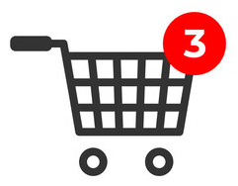
Show amount of items in the shopping cart (User Goal 6)
Use Case
On the Home Page the user expects to receive information about items put in cart, which includes number of items
After pressing shopping cart button user expects to be transferred to shopping cart page.
Scenario
The system shows shopping cart icon, which also shows number of items in shopping.
If user clicks on the icon, he/she is transferred to the shopping cart page.

Slide 19
Sort clothing items in a category by price or name (User Goal 11)
Use Case
On this page user expects to sort shown items according to:
Price
Name
Scenario
The system shows list of CheckBoxes. When user selects a particular CheckBox, the system filters the items according to selection.

Slide 20
View detailed information and photos for each clothing item (User Goal 3)
Use Case
On the Detailed information page user expects:
Items’ preview image
List of secondary images
Item’s price
Description
Item’s rating (5-stars)
Item’s reviews by customers
Possibility to add a new review and rating
Scenario
The system shows:
Item’s preview image
Controls for images switching (Previous/Next Image)
“Price” Label with value
Item description
Customers’ overall rating
Customers’ reviews, which includes:
Scale (5 points) for rating
TextArea for the review itself
“Submit” button

Slide 21
Add an item to the cart (User Goal 4)
Use Case
On the Product Detail Page user expects to add an item to the shopping cart.
After adding an item user expects to see the amount of items on the Shopping Cart icon and in the Shopping Cart Page.
Scenario
The system shows:
After pressing “Buy” button, system updates the number of purchased items on the Shopping Cart icon and in the Shopping Cart Page.

Slide 22
Leave reviews and ratings for purchased clothes (User Goal 10)
Use Case
On the Product Page user expects to leave a review and rate a purchased product. The conditions for these operations are:
User needs to be registered and logged in
User needs to buy an item for leaving a comment under that particular item.
Scenario

Slide 23
View the list of items in the cart (User Goal 5, 6)
Use Case
On the Shopping Cart page, the user expects to have:
Item name, number of pieces, price
Adjust number of items
Total sum for an order
Delete items from the cart
Methods for proceeding or finishing the order
Scenario
The system shows a list of items (as a table) with these columns:
Item name
Amount of a particular item in the cart
“Remove” button
“Go to payment and shipping” button

Slide 24
Modify the cart (delete or change quantity) (User Goal 5)
Use Case
On the Shopping Cart page user expects to change the number of items in the cart or remove them.
It is implemented on a slide above as a part of a Shopping Cart Page functionality.

Slide 25
Select payment and shipment methods (User Goal 8)
Use Case
On this page user expects to see the payment and shipping input fields:
City
Postal code
Street, street number and (optionally), flat number
CC number
Expiration date
CVV-code
Scenario
The system shows the page with the following fields:
“City” Text label and input field
“Postal code” Text label and input field
“Street/Number/Flat number” Text label and input field
“Credit Card number” Text label and input field
“Expiration Date” Text label and input field
“CVV-code” Text label and input field

Slide 26
Review and proceed with an order (User Goal 9)
Use Case
On this page user expects to review the items in the cart, shipment information and payment method. It consists of three major blocks:
Item List Block
Shipment Information Block
Payment Information Block
Scenario
The system shows three major blocks of information and a confirmation button and consists of these elements:
Label and Block for items in Shopping Cart
Label and Block for Shipment
Label and Block for Payment Information
“Confirm” button

Slide 27
Login to the account (User Goal 7)
Use Case
On the User Page user expects to login into the account according to:
Username, which can be either e-mail or phone number
Password
After successful login user expects to be moved to the User Page.
Scenario
The system shows the following elements:
“Username” Label and Input Field
“Password” Label and Input Field
“Login” button and on successful login user is transferred User Page.

Slide 28
User Page (User Goal 7)
Use Cases
On the User Page section user expects:
Adding or changing the following info about a user:
Name, Last Name
City, Street, Street Number, Flat Number
E-mail, phone number
Assigning or changing the password from the account
Login to the User Page

Slide 29
Review the info about payment and shipment methods (User Goal 7)
Use Case
On the User Page user expects to get the information about saved shipment address and credit card credentials.
Scenario
The system shows two blocks:
Shipment information:
Street field
Postal code field
Street number field
Flat number field
Payment credentials:
Credit card number
Expiration date
CVV-code

Slide 30
Task List for the E-Shop
Showing the Home Page
Select a brand
List clothes items according to name and price
Select a particular item
Watch additional photos of an item
Add the clothes item to the Shopping Cart
View the amount of items in the Shopping Cart

Slide 31
Task List for the E-Shop
Remove items from the Shopping Cart
Modify the amount of items in the Cart
View item rating
Show item reviews
Showing the orders’ summary
Show latest arrivals
Show promotional items and special offers

Slide 32
Task Groups
Visual Representation:
Landing Page
List Page
Product (clothes item) Page
Shopping Cart
List of Items
Payment and Shipping
Summary
Login Page
User Page
User actions:
Filter items in the list
Select an item
Add an item to the Shopping Cart
Adjust the amount of items in the cart
Delete items from the cart
Rate purchased item
Add a review for the purchased item

Slide 33
Wireframes
Landing Page
List Page
Product Details
Shopping Cart (Items)
Shopping Cart (Payment & Shipment)
Shopping Cart (Summary)
Login Page
User Page

Slide 34
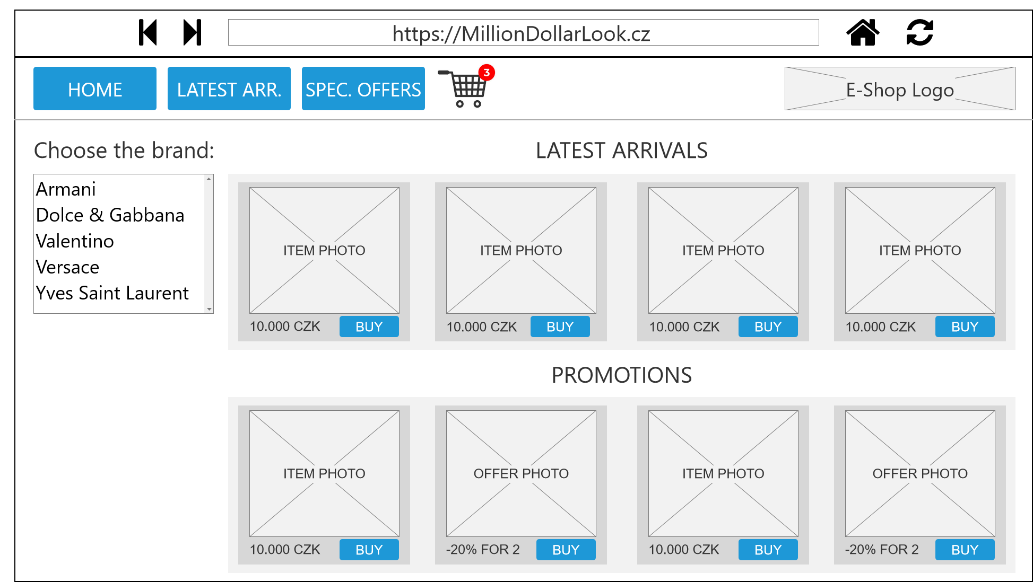

Slide 35
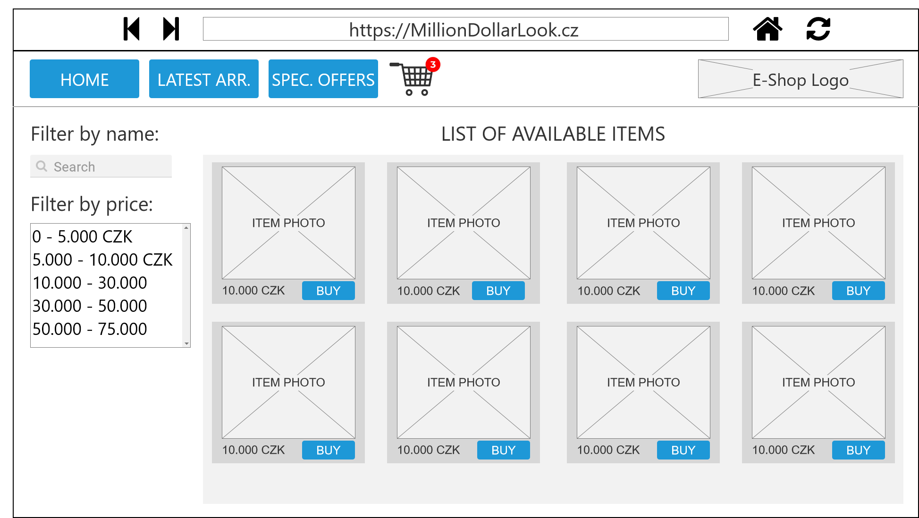

Slide 36
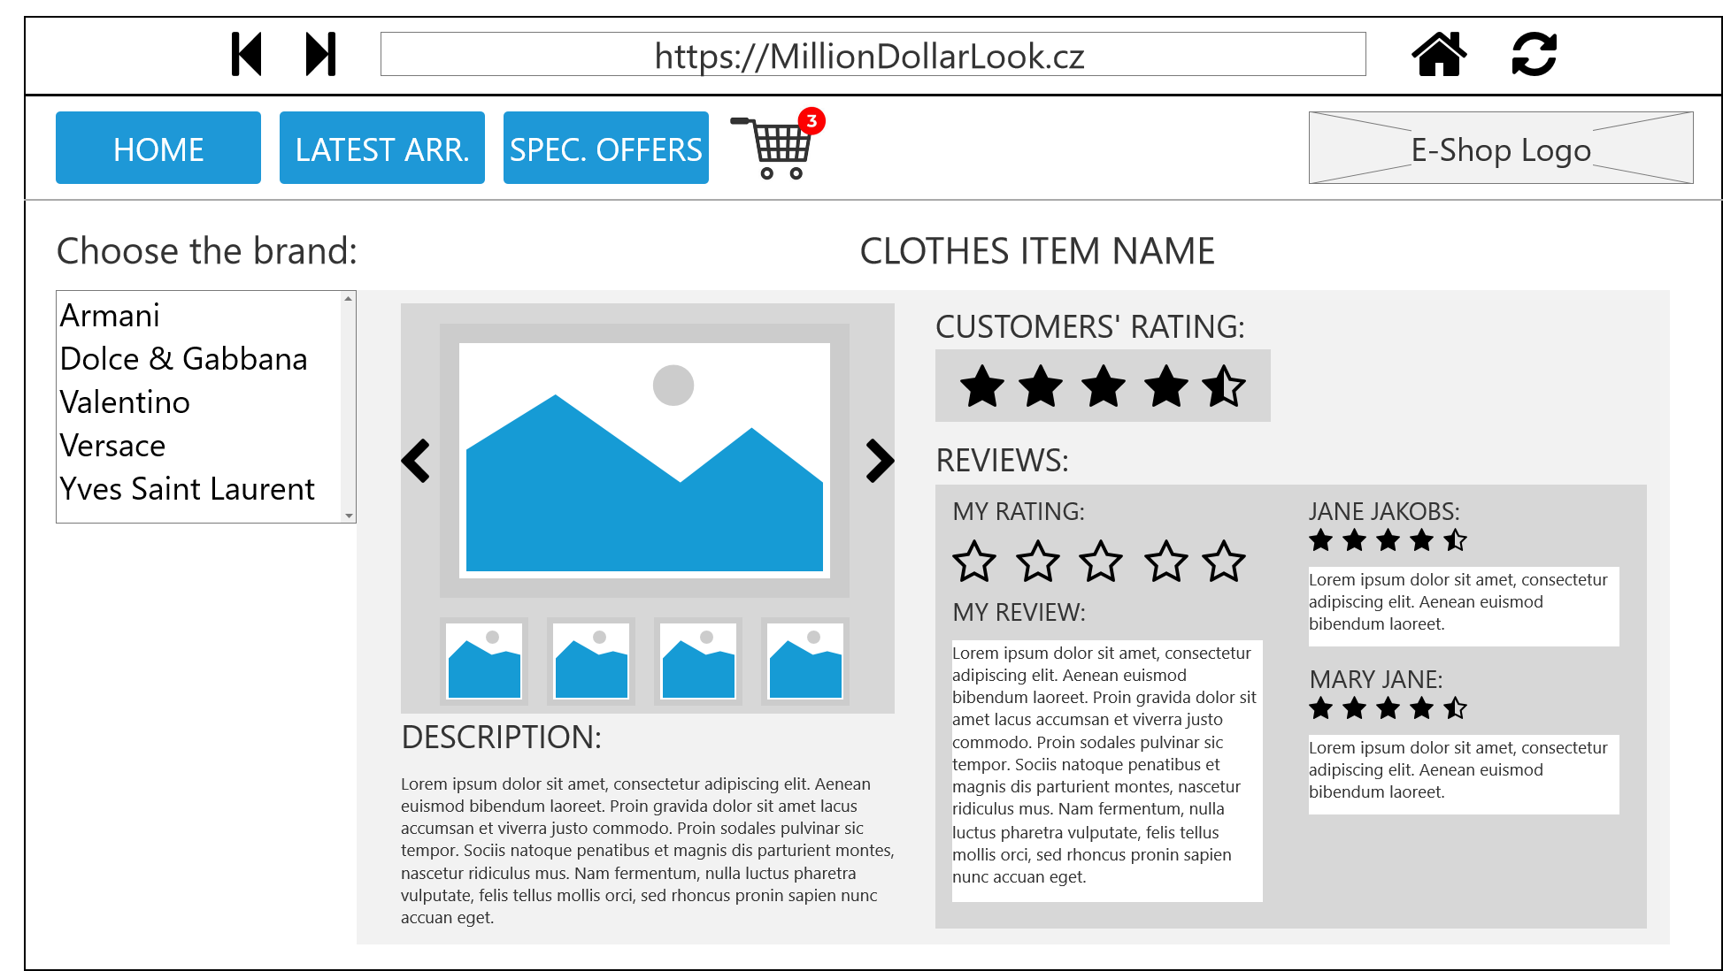

Slide 37
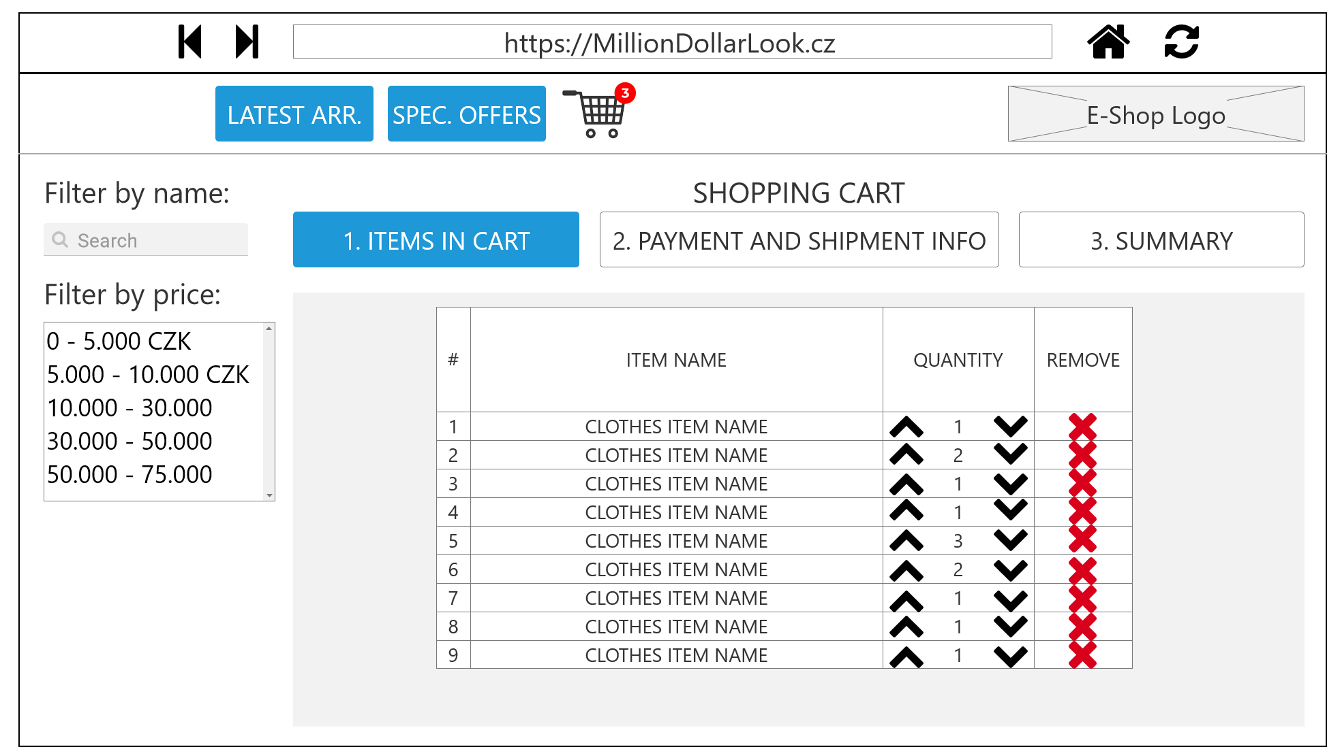
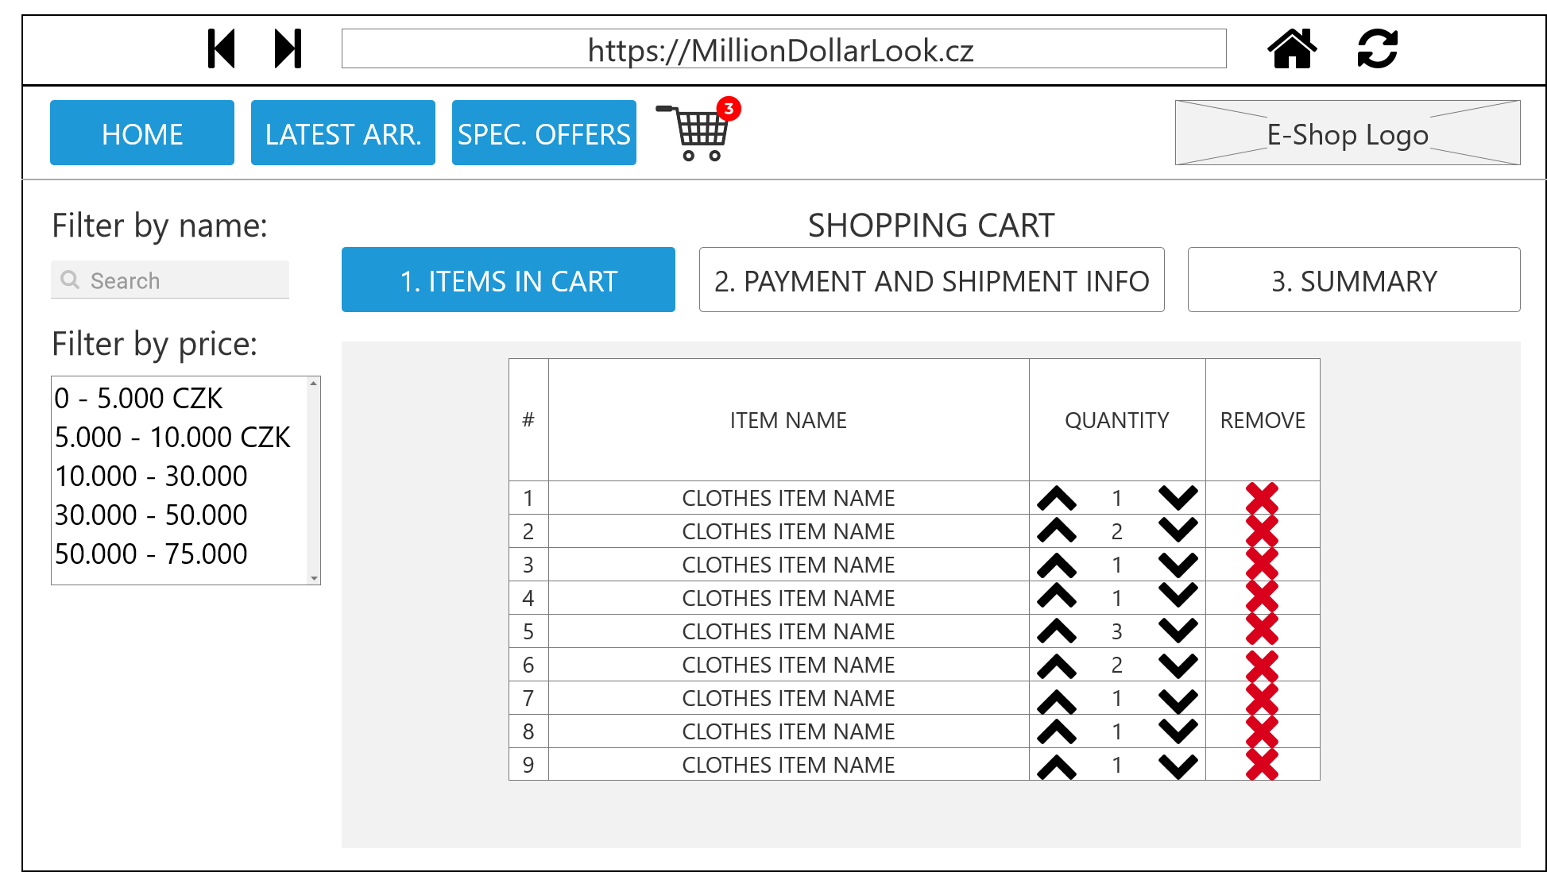

Slide 38
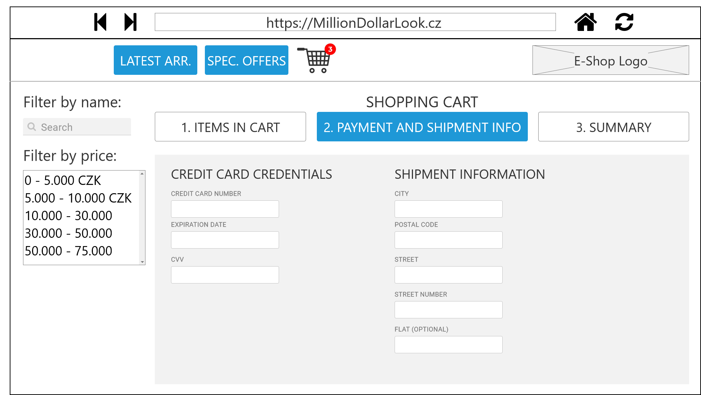
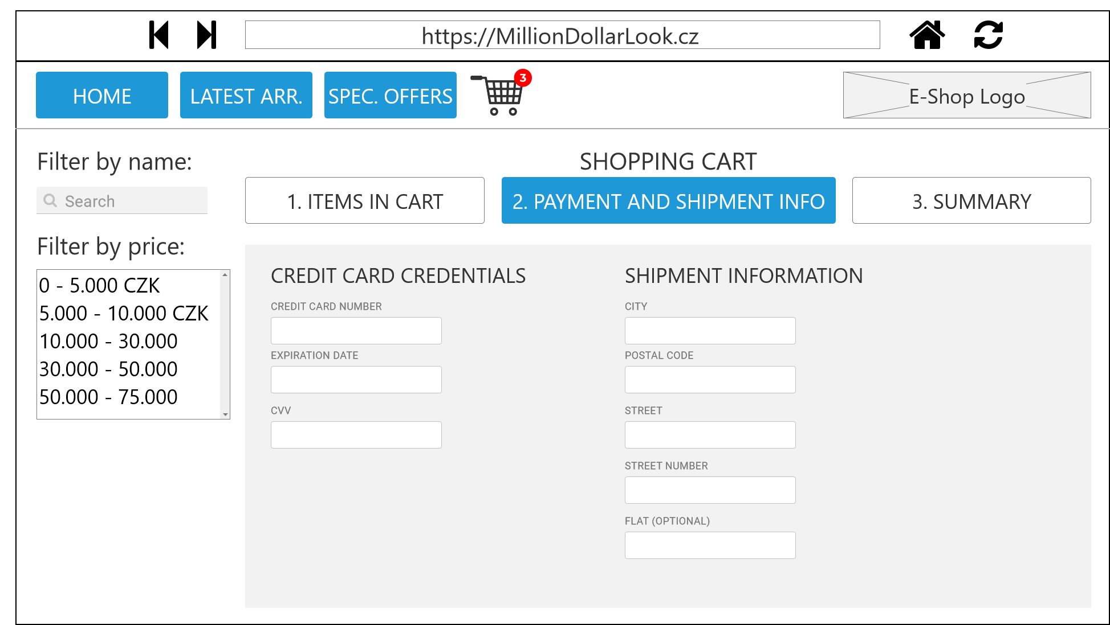

Slide 39
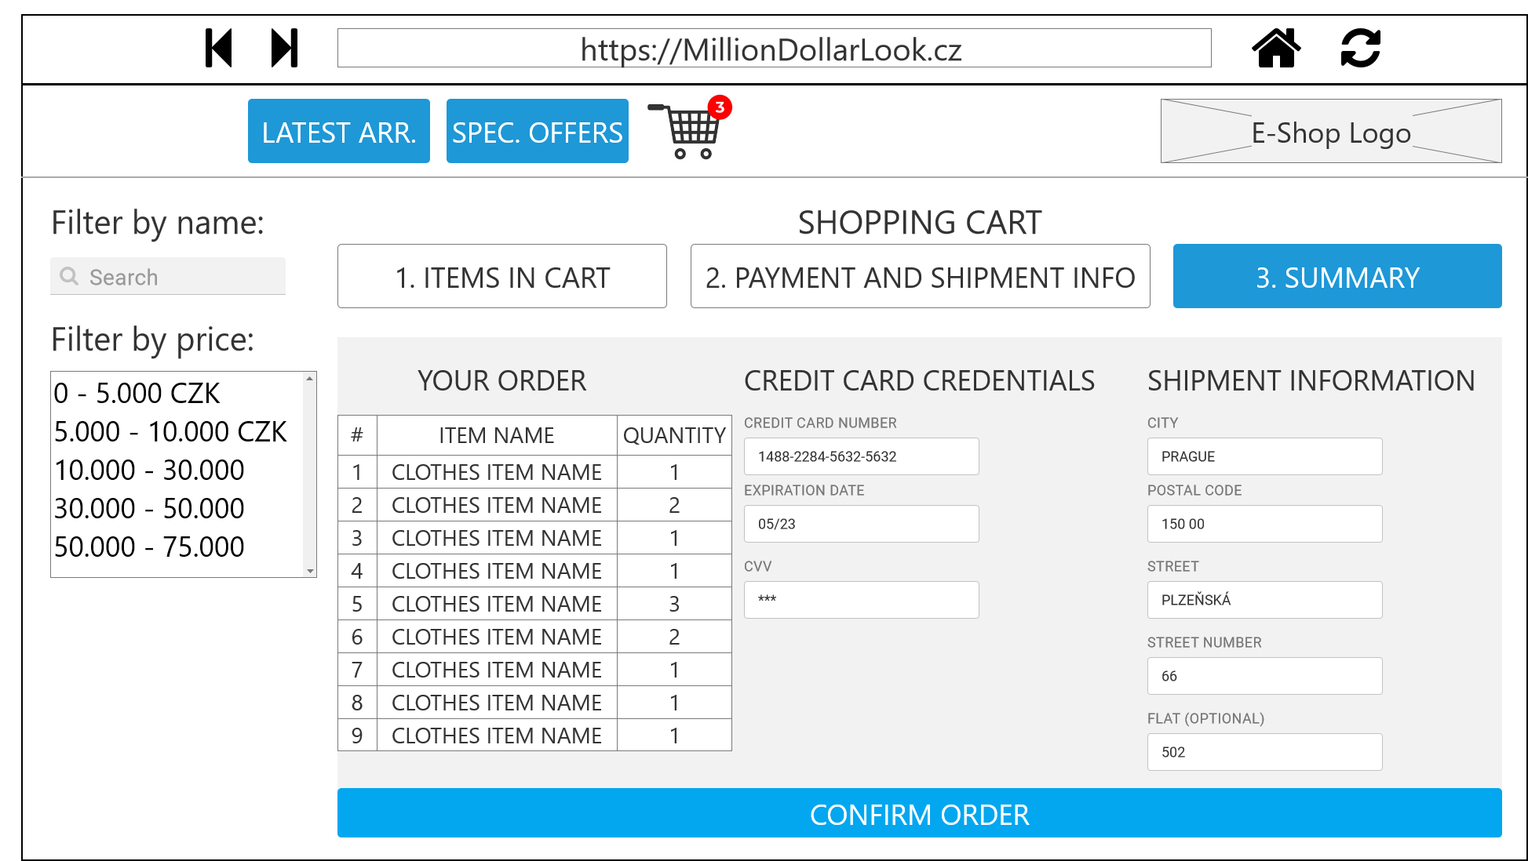
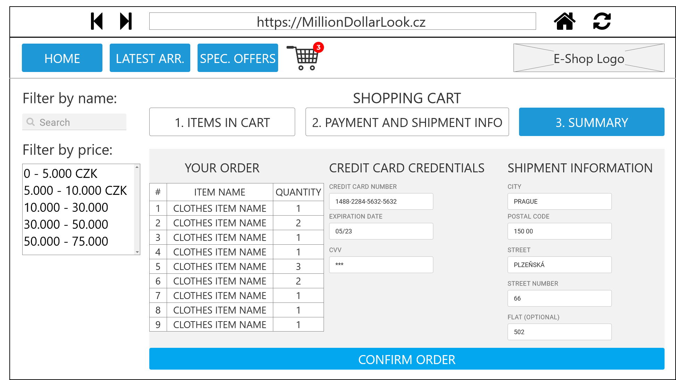

Slide 40
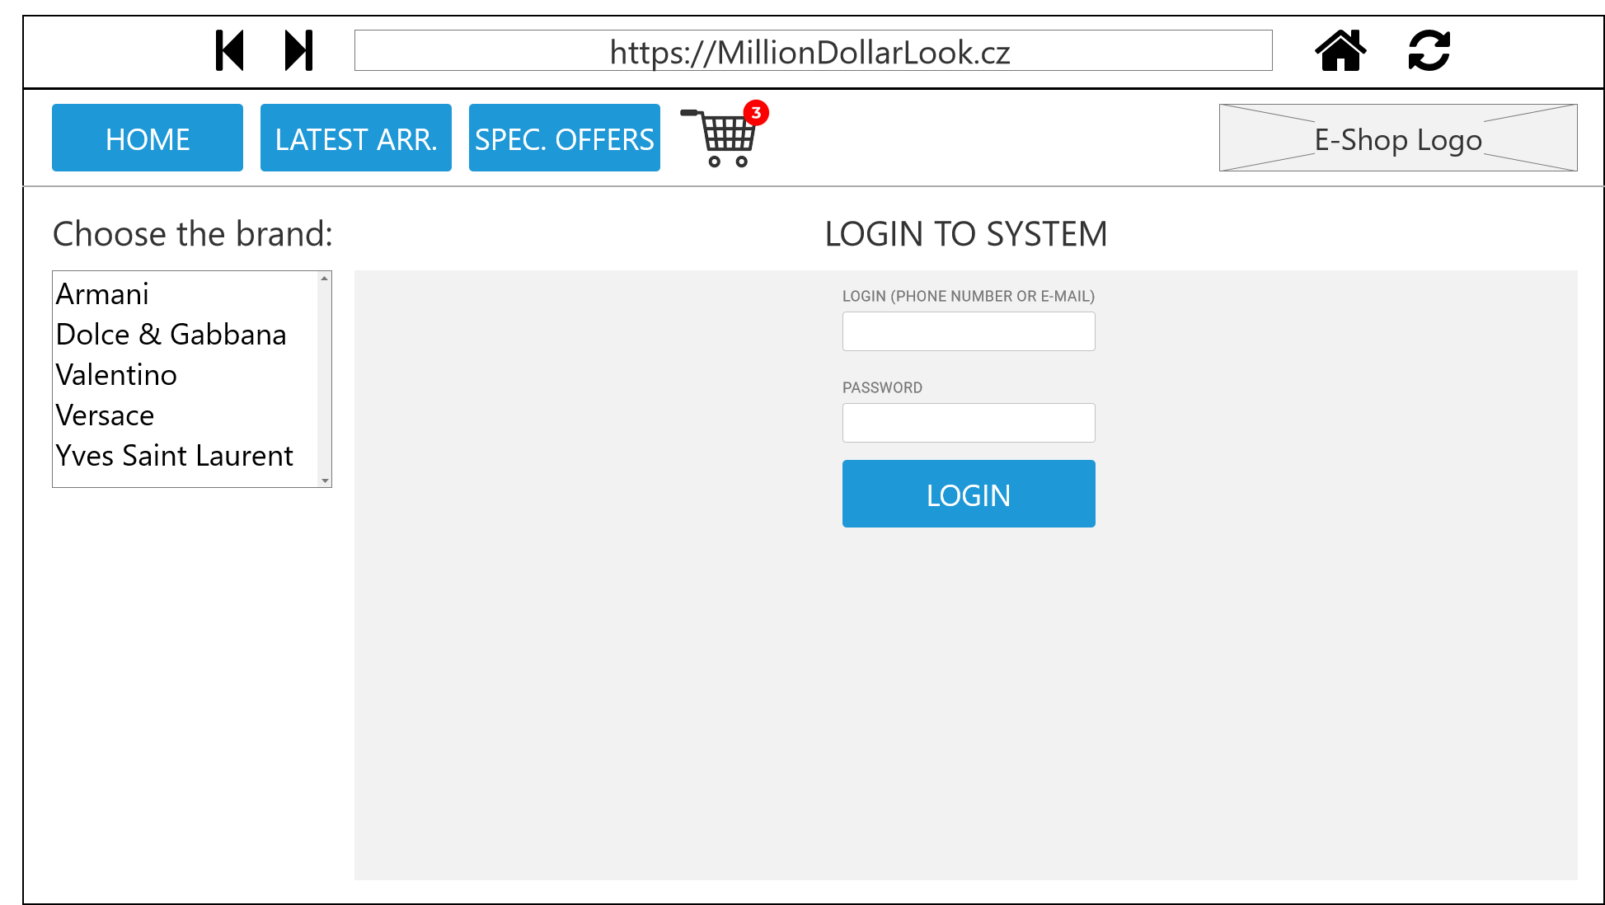

Slide 41
